Slide 1
Deliverable 3

Slide 2
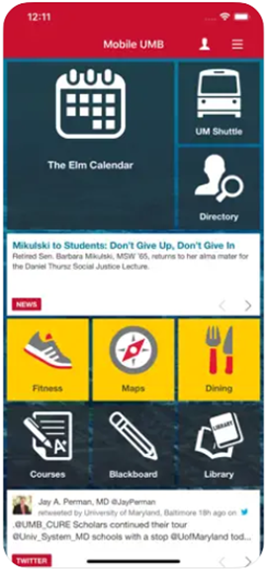
Systems Alternatives
The MyUMBC app used by University of Maryland Baltimore County (UMBC) offers an amazing experience for students, staff, and faculty. It has several been user friendly, simple, and intuitive platform. However, several near universities have used similar systems. For example, University of Maryland Baltimore (UMB) uses the app called UMB mobile, Georgetown University (GU) uses GU mobile, and University of Maryland (UMD) uses University MD. These systems are better in some respects as well as have some concerns compared to the MyUMBC system. Among others, I am comparing the pros and cons of three components within these apps such as live shuttle services, LiveSafe, and Canvas.
UMB mobile
This system is used by University of Maryland Baltimore (UMB). One of the useful features of I found in other systems compared to the MyUMBC is that they offer a live shuttle service. It is a great way to help students, faculty, and staff, especially the students. It is very convenient service for all campus community to ensure their safety through a real time shuttle tracking. This technology simplifies the way you track your location, so it is easier to determine if the buses are on time and traversing only on their assigned routes. This shuttle service is easy to go through and understand and it help the users to make quick and informed decisions on the spot.
Nevertheless, several things can be improved. A high-quality real time shuttle tracker can be scaled to the unique requirements of the for our campus community. Several functions can be incorporated within MyUMBC app also, such as fare collection, voice announcements, automated passenger counting, next stop requests, bus route management, on-board map locations, and arrival and departure updates in real-time. Including such live shuttle service within the MyUMBC app help the campus community, the cost to develop this will increase and students may have to pay for it eventually. Importantly, the app should be safe and secure so that hackers will not be able to access the shuttle service and tracker.

Slide 3
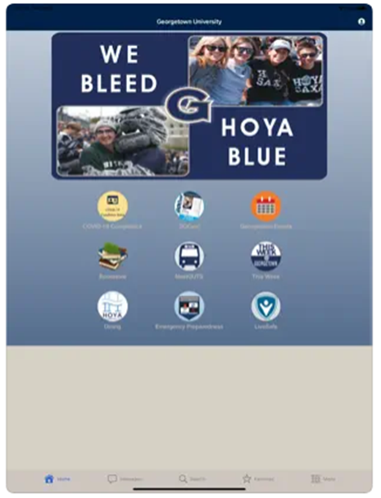
Systems Alternatives
2. GU mobile
This system is used by Georgetown University, and one of the important features in this app is LiveSafe. Personal safety is a vital issue for our society. It is unpredictable when an emergency can happen. So, it's always good to be prepared for the worst situation. The LiveSafe safety app can be used on your iPod touch, iPad, and iPhone and gives you a simple and quick way to receive and share information with your local police. There is software that can identify several aspects of a person, including their face and voice. Some additional features of this app include safety notifications straight from your local police so you can be aware of what's currently happening around you and take proper safety measures. Currently, UMBC community receives security alert through text messages when phone number is registered, but it does not provide the details. Incorporating the LiveSafe App component directly to MyUMBC app will help the community to easily connect with campus police, and give access to security report, help send photos and videos, and do virtual security walks all from the mobile device. A shot-locating sensor system works within an area by tracking the sounds and alerting law enforcement when weapons fire. This can help law enforcement identify exactly where a shot took place and help at the scene. This will be a great feature to add within MyUMBC. However, the cost and individual privacy compliance could be challenging.

Slide 4
Systems Alternatives
3. University MD
This system is used by University of Maryland College Park (UMD) and Canvas is an important feature within the app. The UMBC campus community uses Blackboard as teaching learning resource. It is a great resource available in web-based system, this has not been fully incorporated into the MyUMBC app system. Incorporation of Canvas as an alternative can help students and faculties in effective learning and teaching. The Canvas App can be accessed through any device, including tablets and mobile phones. The users can access the application from any place at any time. The app offers essential features like drag and drop interface, built-in controls, multi platform compatibility, and appealing user interfaces. It can be used in different industries, including project management, human resource, sales management, customer relationship management, and event registration.
Some cons of the Canvas app include automatic erasing of the assignment when the due date is not set at midnight, technical problems in audio recording, no recording of the students’ messages until the teachers provide replies and unable to deal with more assignments together. Having this system as an alternative could be very powerful for students and faculties. However, cost associated with the incorporation of the app to MyUMBC may be high compared to improving already existing Blackboard system and training the community with the new system usage could be challenging.

Slide 5

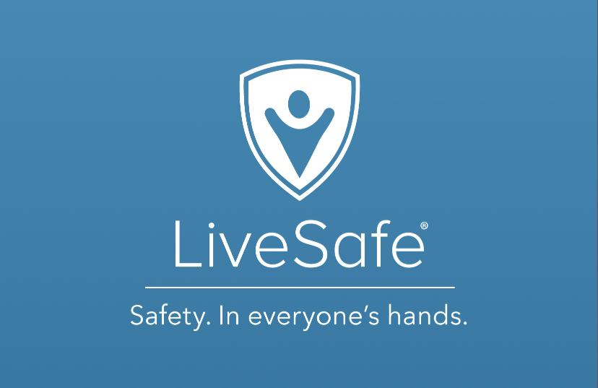
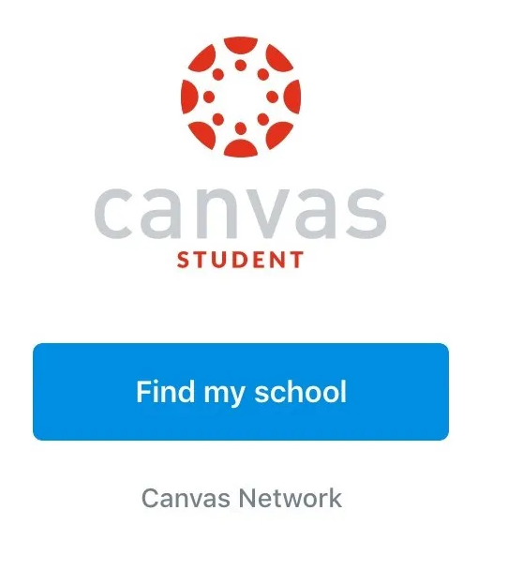
Systems Recommendation
Out of all the alternatives, the most optimal option would be to add a shuttle improvement feature to the myumbc app. As of right now, the shuttle feature on myumbc directs the user to another app called Transloc. Currently, users are faced with glitches and overall dissatisfaction towards the features of the app. Improving the shuttle feature of the UMBC app can promote the UMBC shuttle and the different locations they provide, as well as nearby routes. The improved shuttle system would include real time shuttle tracking and the ability to look into multiple different routes on the app itself. The improvement of the shuttle feature can also incorporate different functions such as bus route management, on-board map locations, arrival and departure updates in real times, as well as automated passenger counting. The cost would develop with adding these additions to the app, however they prove to be a great benefit for the UMBC student, faculty, and staff. One of the other alternatives we researched was Canvas. Canvas is another teaching learning tool that other universities currently use. While UMBC uses Blackboard as its tool, it is not fully integrated into the myumbc app and thus makes using the app less efficient, giving no incentives for its users. The pros of Canvas was how easily it can be incorporated into myumbc, with its low code. It proves to be a cost-effective platform for the university. However, the process of changing learning and teaching systems that have already been implemented proves to be a challenge that will have to be dealt with on a large scale, with communication having to be relayed to the top. The other and last alternative was a Livesafe app to be incorporated to myumbc. This feature would be primarily used for safety on campus, such as safety notifications from the local police. Other features include security alerts as well as the ability to send photos and videos to the local police. The cost would be significantly greater than the other two alternatives, in addition to individual privacy compliance serving as a challenge. Ultimately, we believe that the shuttle improvement would prove to be the most useful for UMBC students, and gives them more of a beneficial reason to use myumbc more.

Slide 6
Systems Proposal
Our team completed a systems study by interviewing students, interviewing developers, and researching the applications used by nearby universities. After doing some research comparing and contrasting myUMBC app features with that of with competing universities in the DC/Maryland area, evaluating system alternatives, and comparing costs across the board, we decided that upgrading our public transit system would be beneficial for members of the community.
The live shuttle application would be a feature that improves the myUMBC application once it is fully functional. Due to live shuttle giving more resources for students to get to school/class and using real time data it will be an innovation to the myUMBC app.

Slide 7
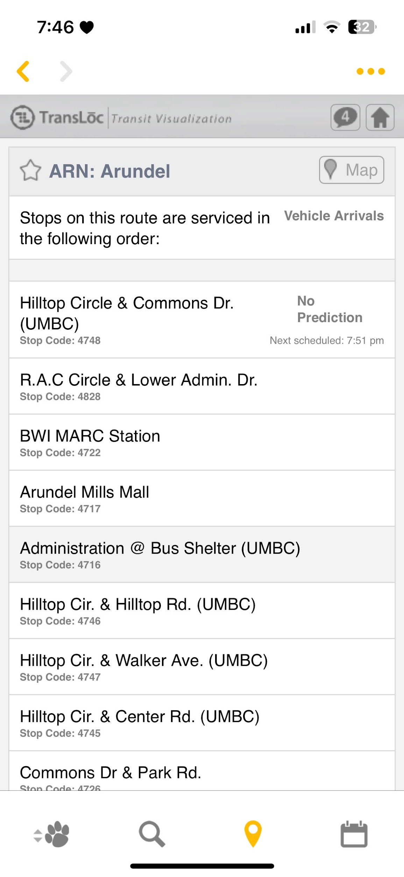
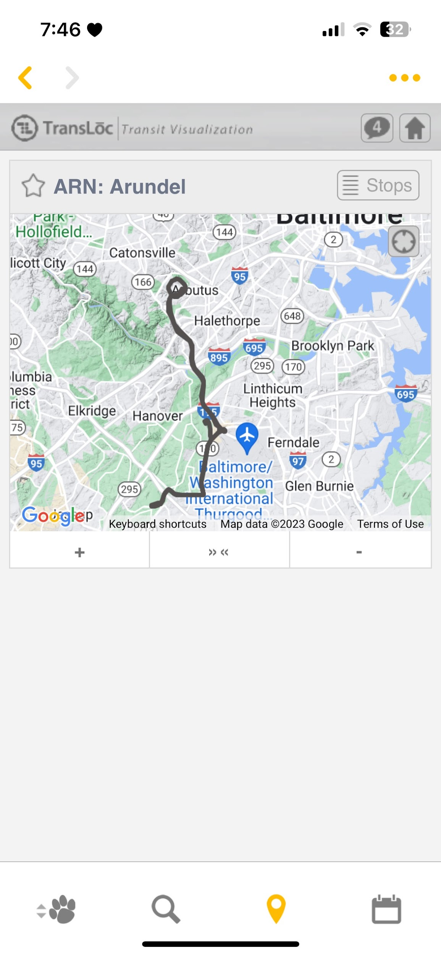
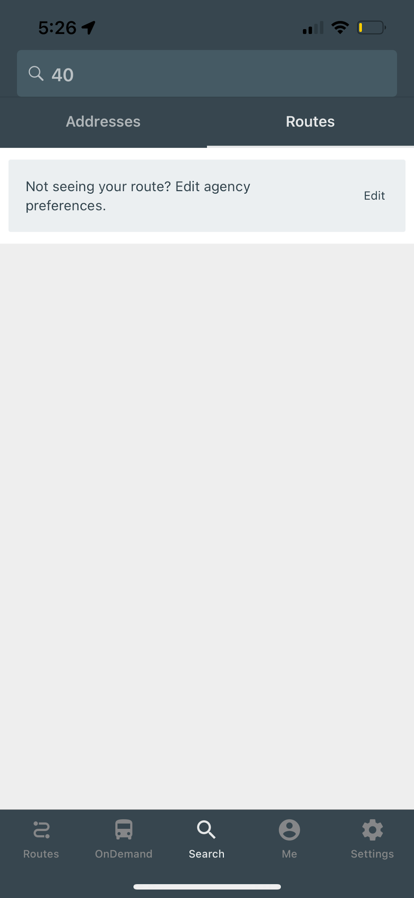
Input/Output Screens
Our main focus of improvement is our transit system app. The current issue with the UMBC transloc app under myumbc is that it does not provide specific information about routes. Users complain that the app is good for looking at current routes but the app does not show different schedules in full, bus breaks/delays.

Slide 8
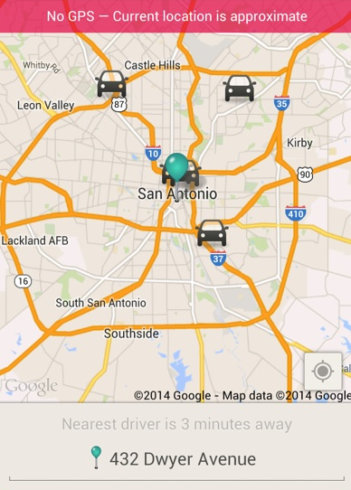
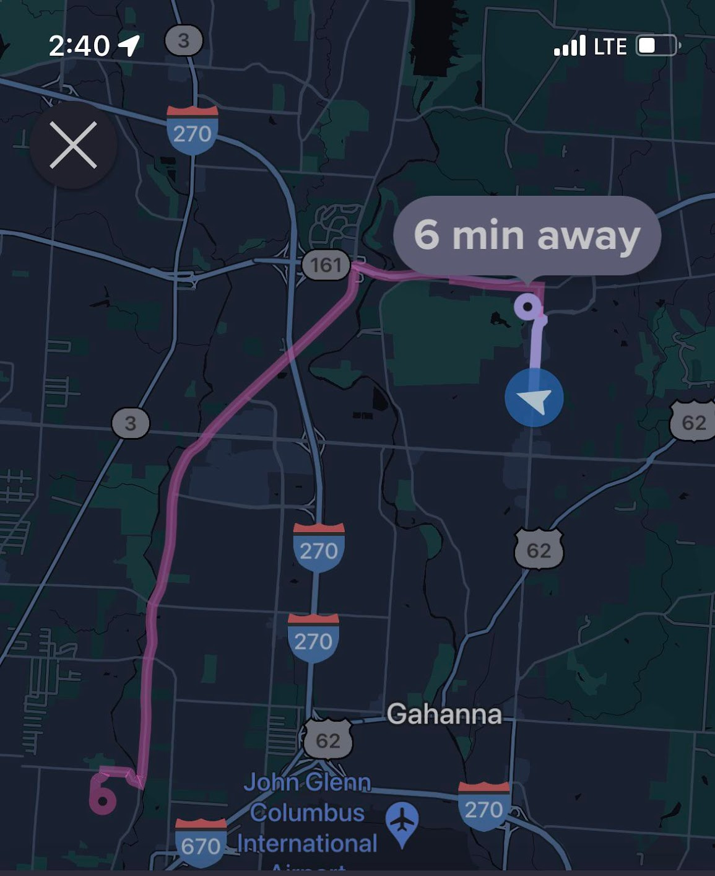
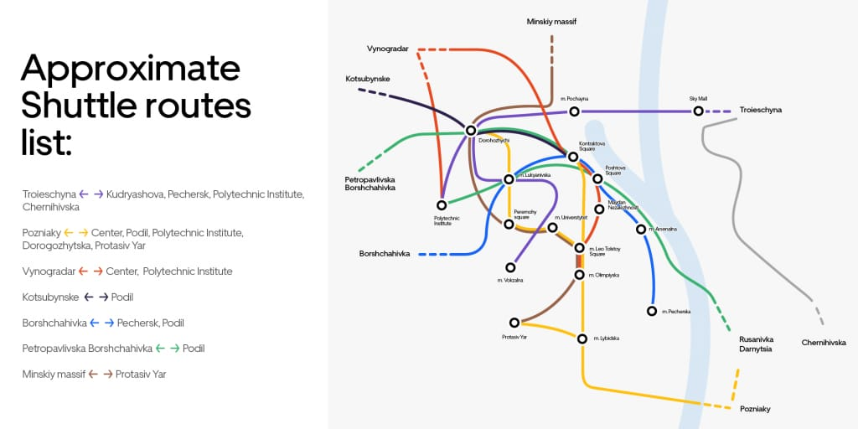
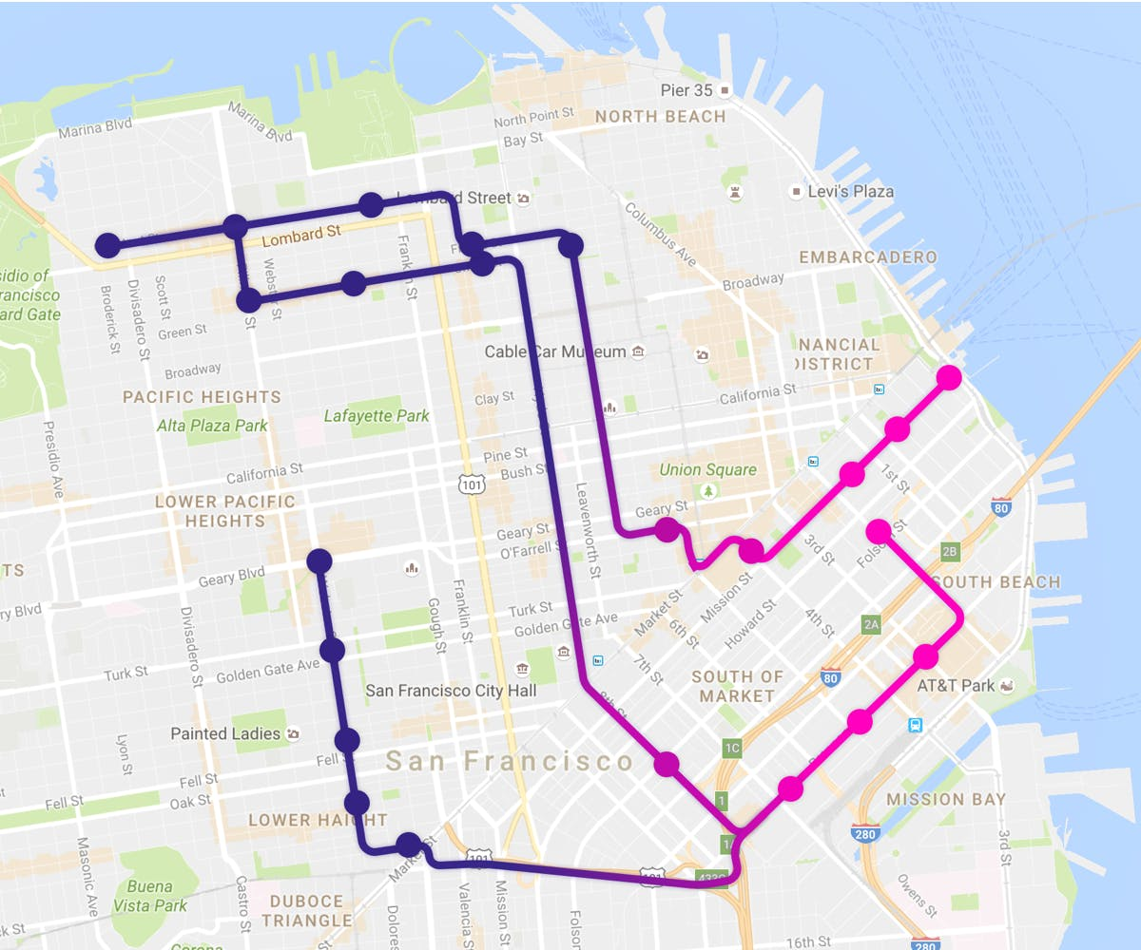
Proposed Input/Output Screens
We’re looking to update the UMBC transloc app to be similar to Lyft, where you can see search for your destination & the app will pull up a variety of different bus routes that will lead you to that search query. The app will also show the bus moving in real time with an icon to make users see bus delays/breaks and get real-time updates. Lastly, we’ve added a feature where users can permanently save bus routes within the app rather than checking on the transit tracker hyperlink on myumbc

Slide 9
Executive Summary
Our group was assigned with the task of reaching out to a company in order to assist with a need/opportunity for improvement/problem with a process, procedure, or project that can be solved with technology. We decided to reach out to the UMBC team that oversees the myUMBC mobile application. The reason for this decision came from the issue with the myUMBC application never working or being functional. Since our group has been here at UMBC the application has never worked and none of us have used the application due to this problem. We wanted to help solve this problem as well as possibly add in new features that could potentially make the application more useful overall.
The best solution to the myUMBC application would be to improve the development of the application in order to get a functioning application, however using a system alternative the best solution would be be adopting another software such as canvas that is already working. The live shuttle application would be a feature that improves the myUMBC application once it is fully functional. Due to live shuttle giving more resources for students to get to school/class and using real time data it will be an innovation to the over myUMBC. As well as future development and addition features that could be implemented soon such as average test scores view and input scores to view impact on grade. The best solution would be to innovate and implement myUMBC with software such as live shuttle.

Slide 10
Documentation
Questionnaire: https://forms.gle/NwMTEMA9jVjnwEfu6
Interview Questions & Answers: https://docs.google.com/document/d/11k9JRxqrTIDplEPz6dMS2xh3VblaJcrTUCX7Q97H5qU/edit?usp=sharing

